Slide 1

AIRBNB HOTEL BOOKING ANALYSIS
Atchayaa I
INTERNSHIP_17546440516895be537820f

Slide 2

PROBLEM STATEMENT
The way we travel and stay in new places has changed forever. Platforms like Airbnb have turned ordinary homes into short-term lodgings. This project was initiated to explore Airbnb listings across New York City (NYC) to uncover the hidden patterns and trends driving this bustling market. The core goal is to generate actionable insights for key stakeholders.

Slide 3
PROJECT DESCRIPTION
This project leverages the New York City Airbnb Open Data to perform exploratory data analysis and visualization. By cleaning, preparing, and analyzing the dataset, insights are drawn about:
Distribution of listings across neighborhoods
Variation of prices with location and property type
Host activity and availability trends
Popular room types and occupancy patterns
The analysis helps stakeholders understand the market dynamics and make data-driven decisions to optimize business strategies.

Slide 4

WHO ARE THE END USERS?
HOSTS
To optimize pricing and occupancy rates.
TRAVELERS/GUESTS
To identify affordable and well-rated stays.
AIRBNB PLATFORM
To improve customer satisfaction and market strategy.
RESEARCHERS & ANALYSTS
To study tourism trends and housing market impact.

Slide 5

TECHNOLOGY USED
Programming Languages
Python
Libraries
Pandas
Numpy
Matplotlib
Seaborn
Environment
Jupyter Notebook
Dataset
NYC Airbnb Open Data
Visualization tools
Python data visualization libraries for Charts & Plots

Slide 6
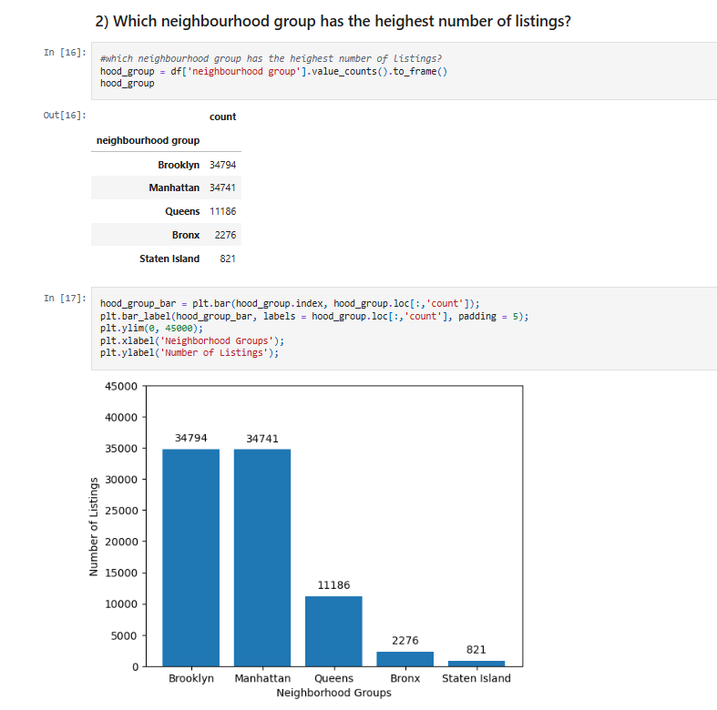
RESULTS-1

Slide 7
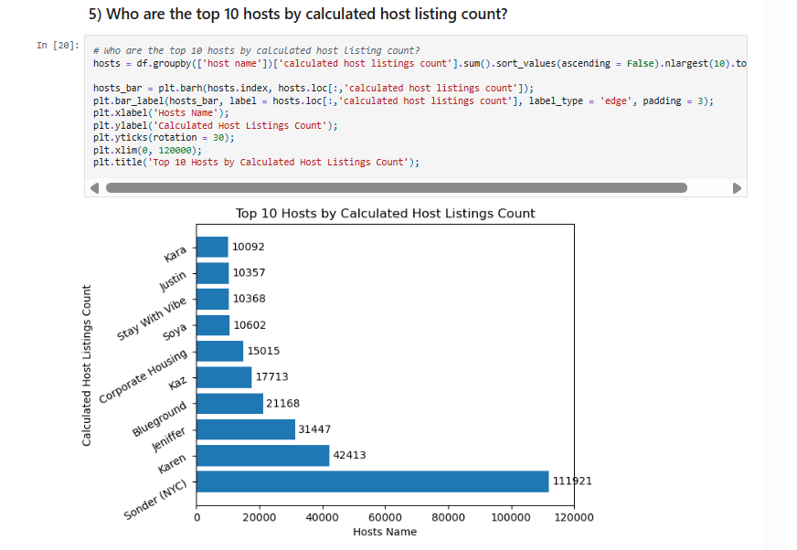
RESULTS-2

Slide 8
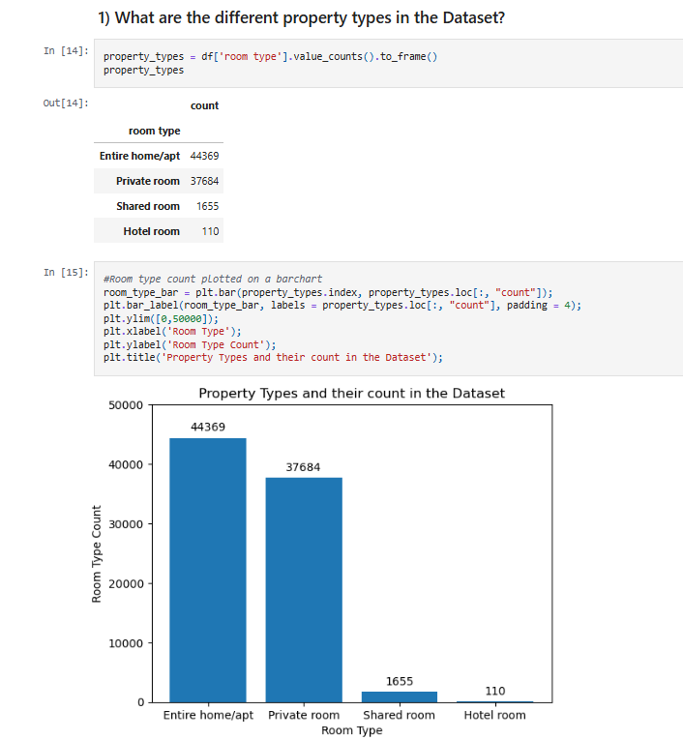
RESULTS-3

Slide 9
GITHUB REPOSITORY
URL : https://github.com/atchayaah/VOIS_AICTE_Oct2025_Atchayaa

Slide 10
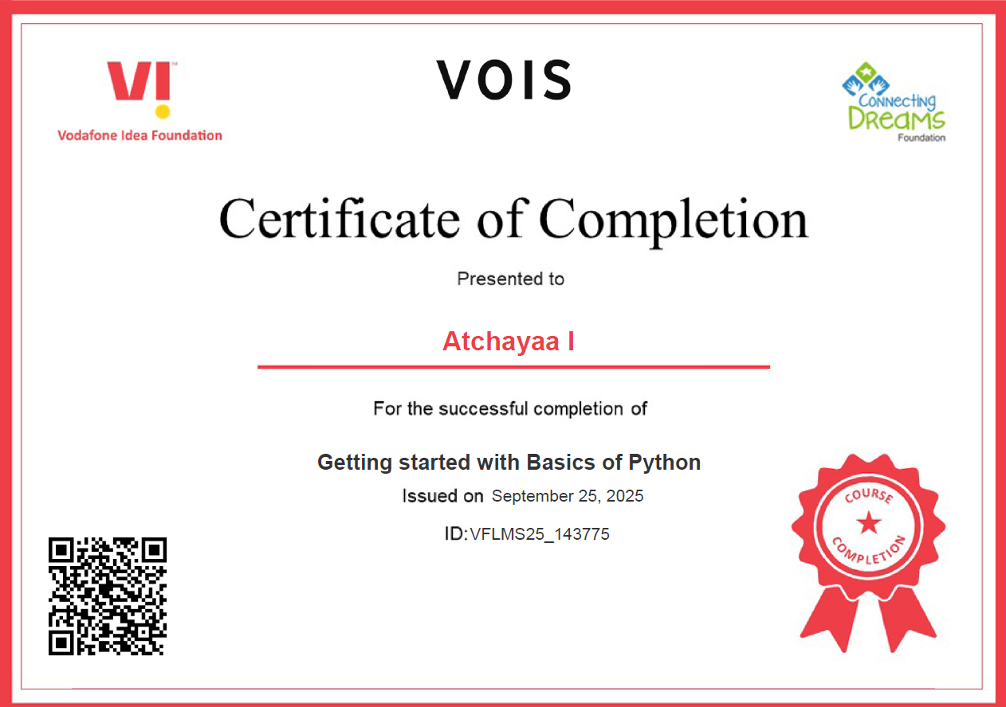
GETTING STARTED WITH BASICS OF PYTHON CERTIFICATE

Slide 11
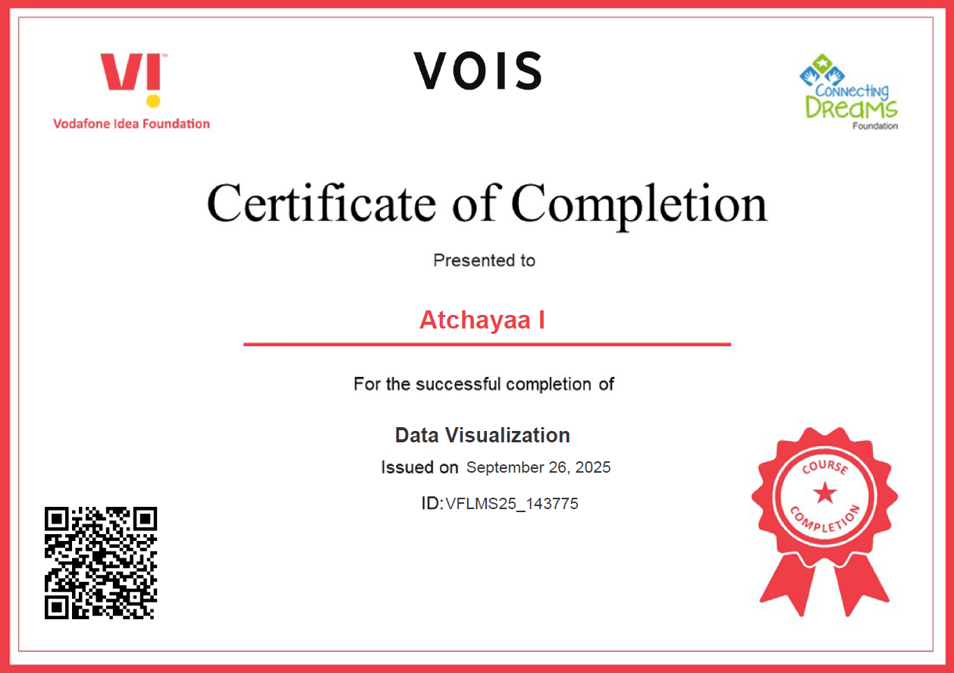
DATA VISUALIZATION CERTIFICATE

Slide 12
THANK YOU
.
.

